Slide 1
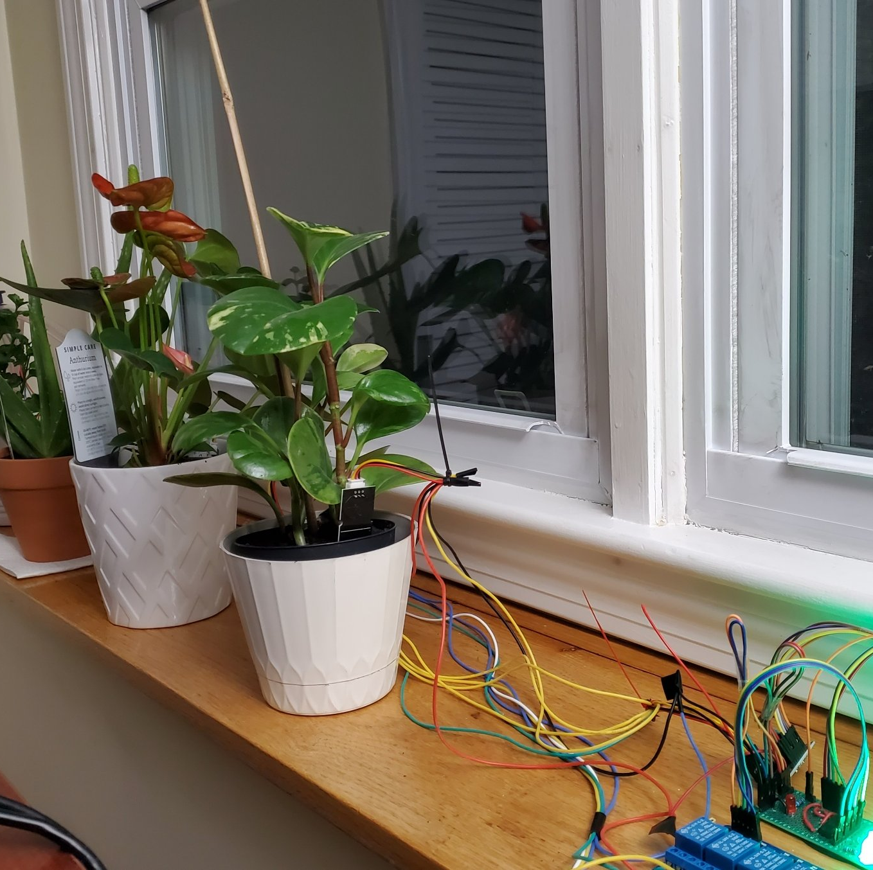
Smart Wearable device for plants
Presented By : -
Satish Kumar
Saroj Kumar
Ekhlakh Ahmad
Sonpal

Slide 2
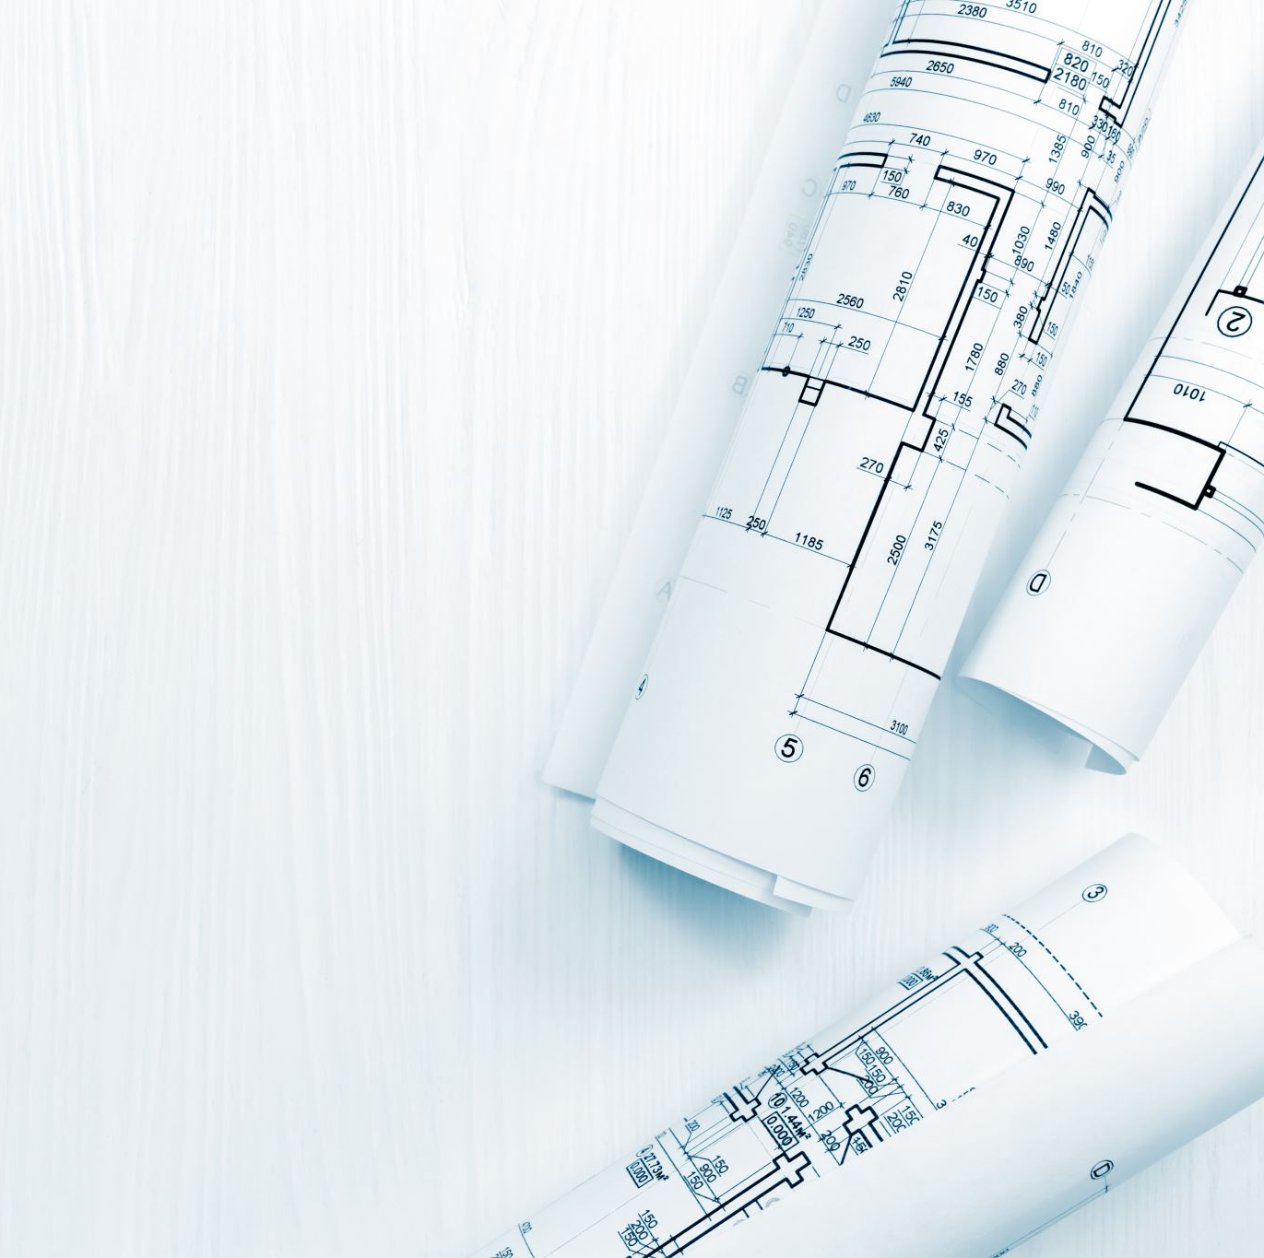
Contents
Problem Statement
Introduction
Past Work
Block Diagram
Components Details
Circuit Diagram
Working
Why It’s Important
Advantages Of The Invention
Conclusion and Future Scope

Slide 3
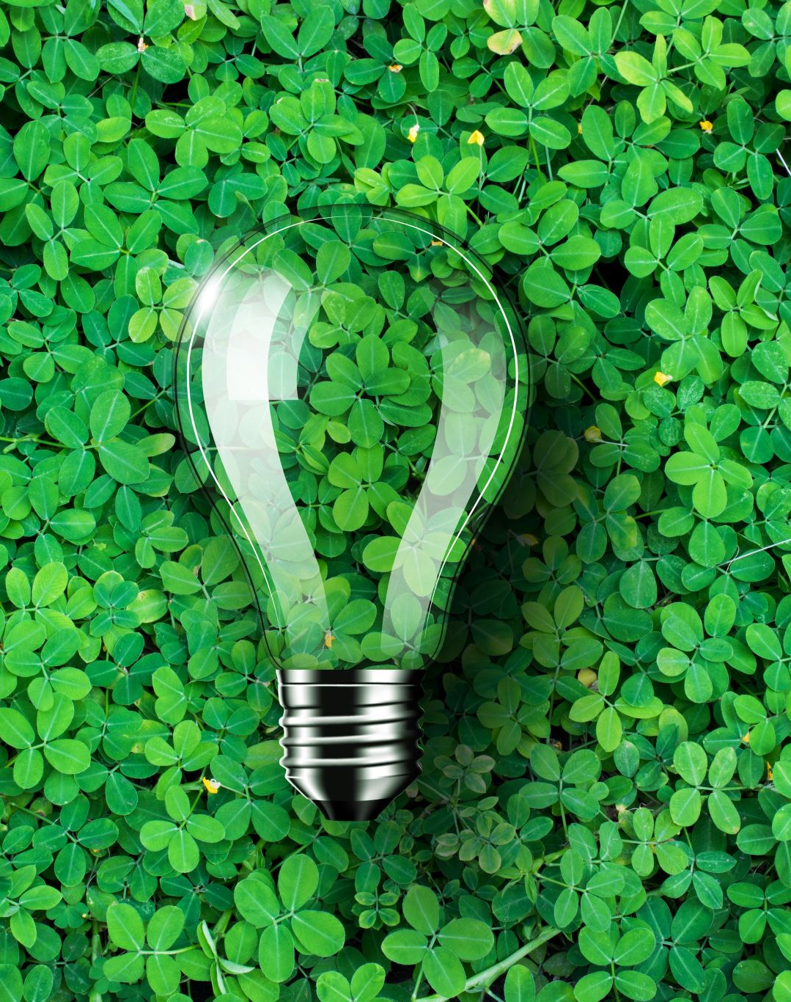
Problem Statement
In a world where technology meets agriculture, our work comes with an innovative solution: ‘Smart Wearable devices for plants’. Traditional plant care methods are often inaccurate, resulting in over or under watering and insufficient light, affecting crop yields and the environment Our project aims to solve this challenge with sensors advanced technology, real-time analytics and IoT connectivity to provide personalized care for each plant Directly Accessible through an easy-to-use mobile app, which allows plants to be monitored remotely. This innovation promises to improve plant health, increase yields, and promote sustainable agricultural and urban gardening practices, along with technology-driven solutions for plant care.

Slide 4
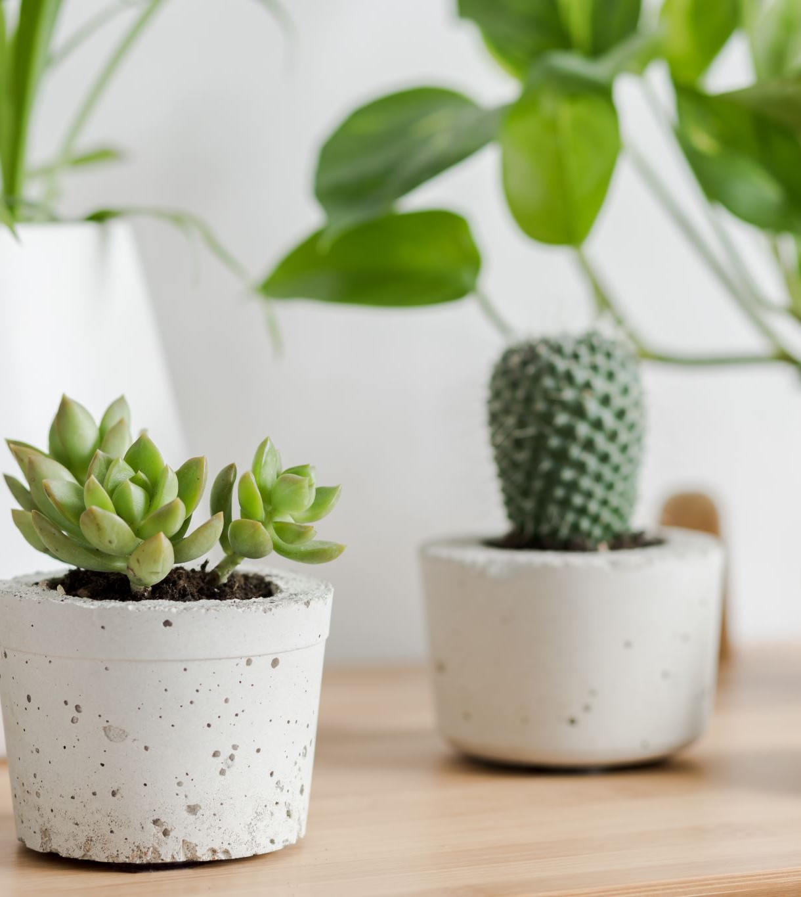
Introduction
In today's world, technology is getting smart. You know how your phone connects to the internet? Well, think about your plants doing something similar.
We're making a special gadget for them. It's like a plant's digital helper. This gadget uses smart sensors to keep an eye on things like temperature, light, and how much water the plant needs.
The best part? You can check on your plants using your phone, no matter where you are. This project isn't just about plants; it's about making our planet greener and healthier for everyone. Let's explore how technology can make taking care of plants super easy and good for the environment.

Slide 5
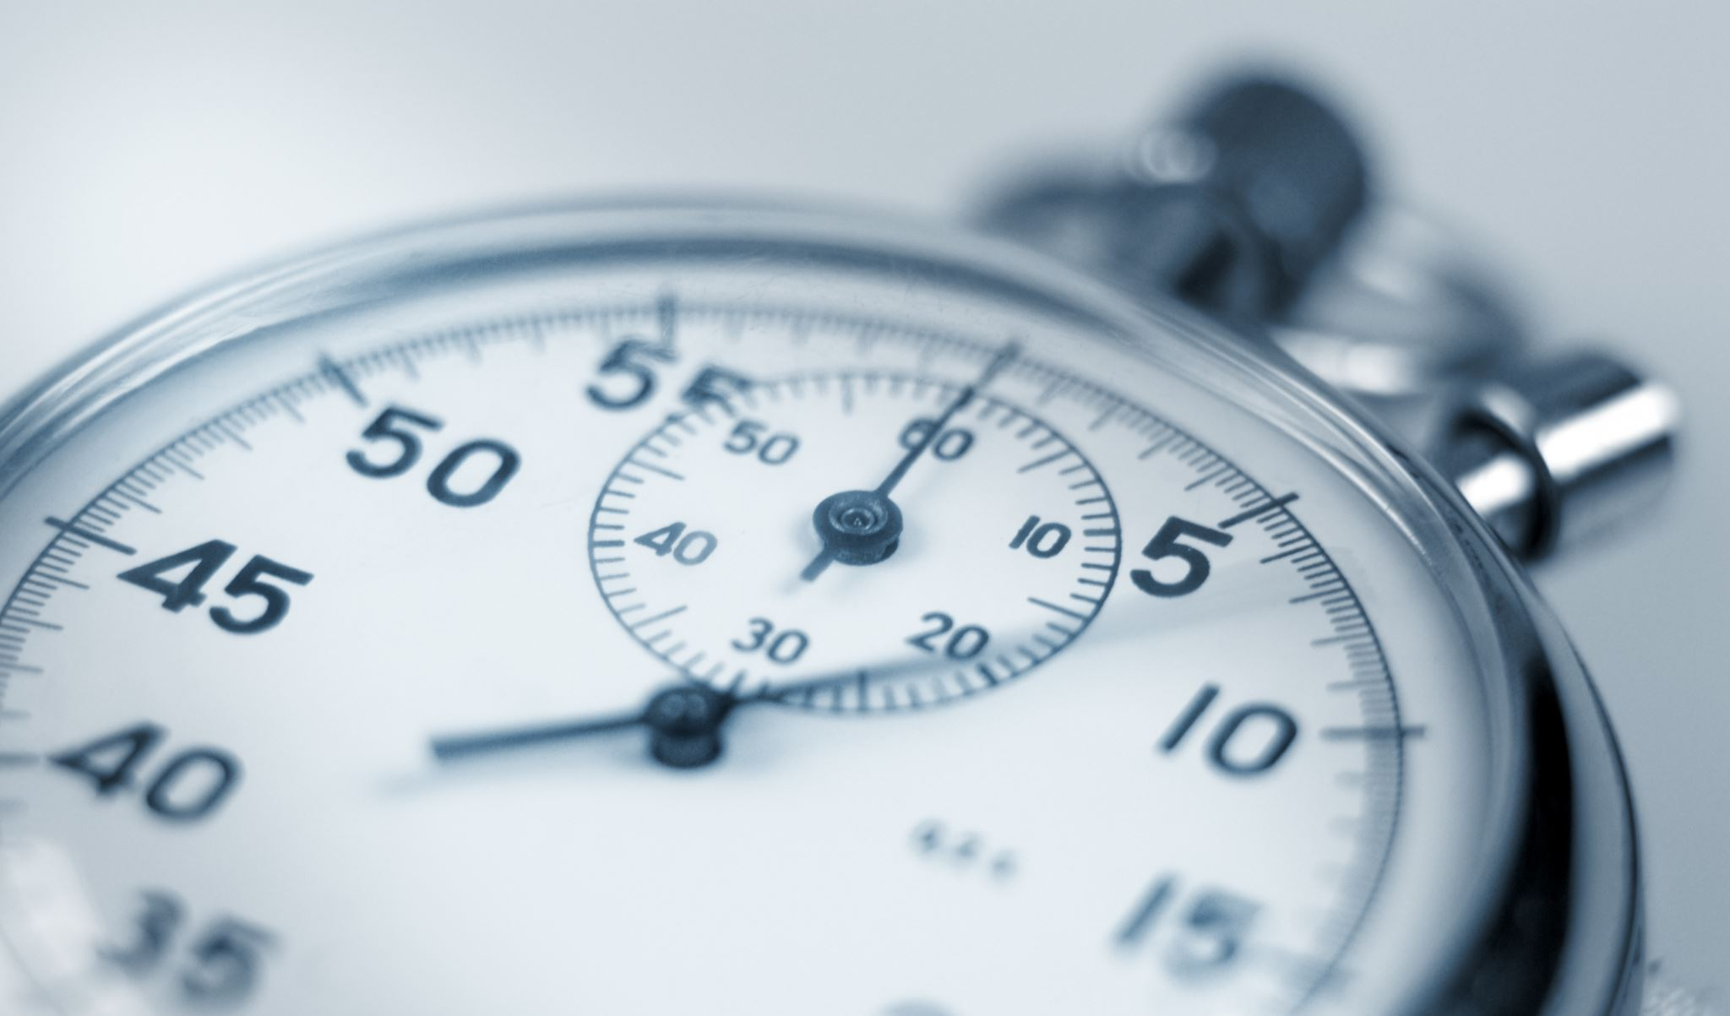
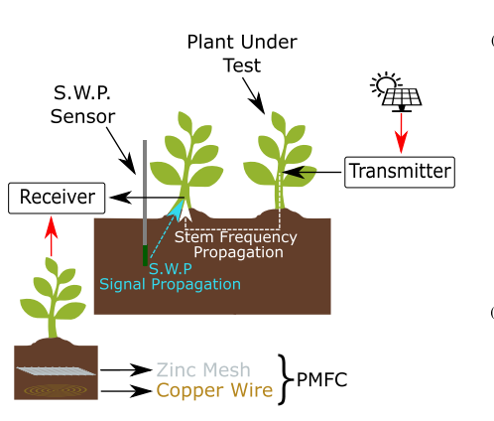
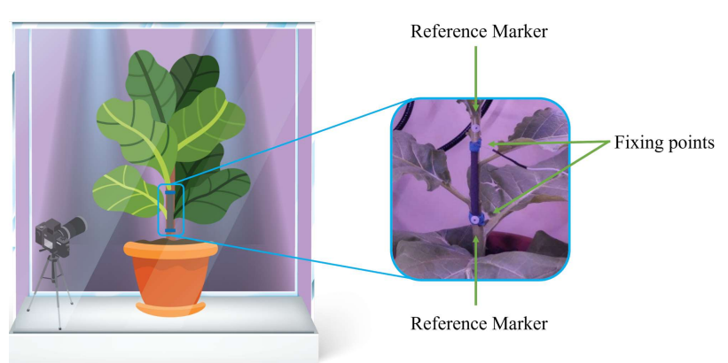
Past Work
Created a Plant Wearable System for the health monitoring using Raspberry Pi Zero. Used different Texas Instrument sensors like LMC555 (Relaxation Oscillator), HDC2080 (Temperature and Humidity), OPT3001 (Light Intensity) that will measure all the parameter. (2023)
Created a Wearable device for plant growth monitoring that monitor the growth of the plant using camera and a BME280 for Temperature and Humidity sensor. (2022)

Slide 6
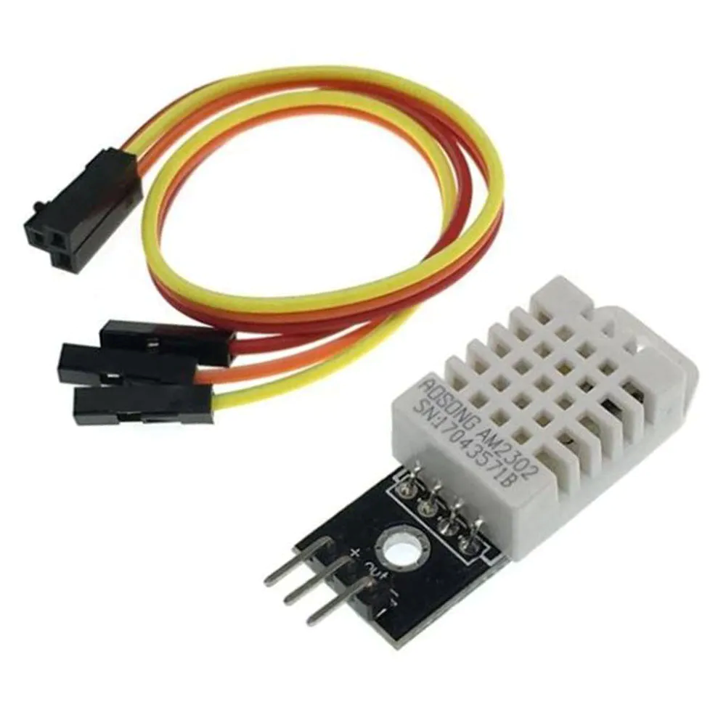
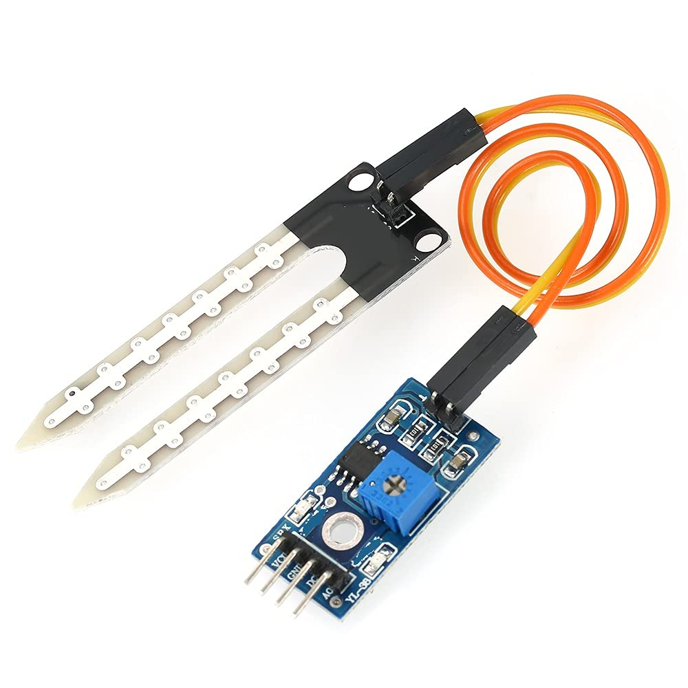
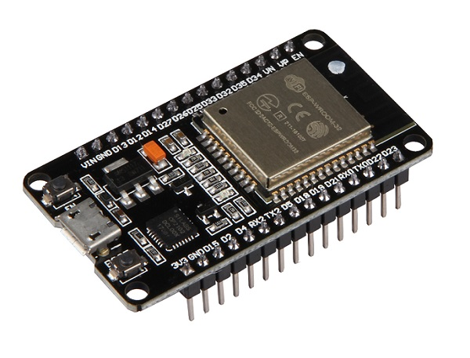
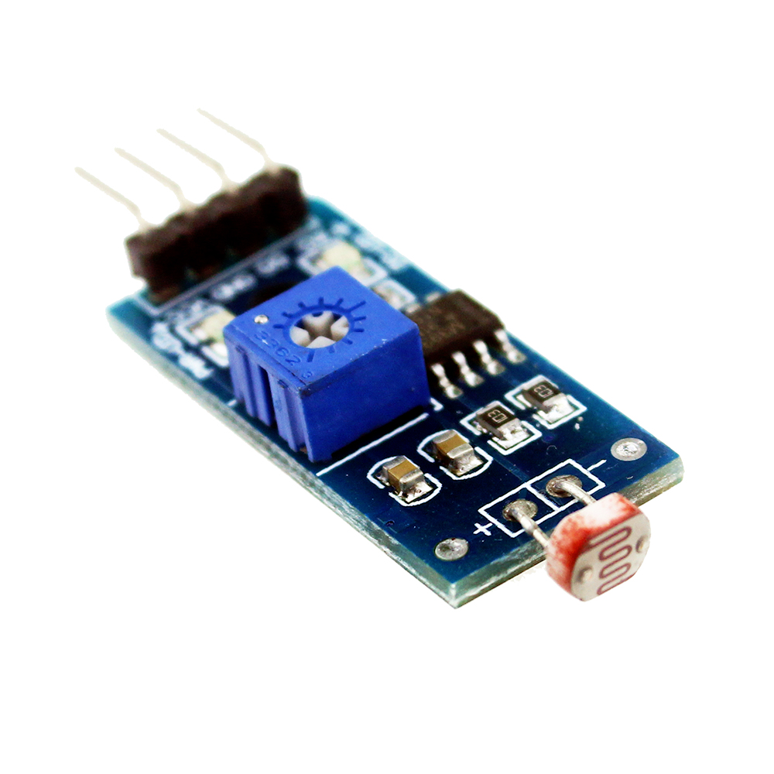
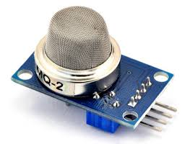
Block Diagram
Soil Moisture
Sensor
DHT22 Temperature and
Humidity Sensor
NodeMcu
MQ135 Air Quality
Sensor
LDR Sensor

Slide 7
Components Details
Soil Moisture Sensor:
A soil moisture sensor is a device that measures the moisture content in the soil. It helps in determining whether the soil is too dry or too wet for optimal plant growth.
LDR Sensor (Light Dependent Resistor):
An LDR sensor, also known as a light-dependent resistor or photoresistor, is a component whose resistance changes with variations in light intensity.
DHT22 Sensor:
The DHT22 sensor is a type of digital temperature and humidity sensor. It accurately measures both temperature and humidity levels in the surrounding environment.
MQ135 Air Quality Sensor:
The MQ135 is an air quality sensor that is commonly used to measure various aspects of air quality, particularly in indoor environments.
Nodemcu ESP32:
The Nodemcu ESP32 is a popular microcontroller board that combines Wi-Fi and Bluetooth connectivity with the processing power of the ESP32 chip.
It is widely used in IoT projects due to its capability to connect to the internet, making it suitable for remote data monitoring and control.

Slide 8
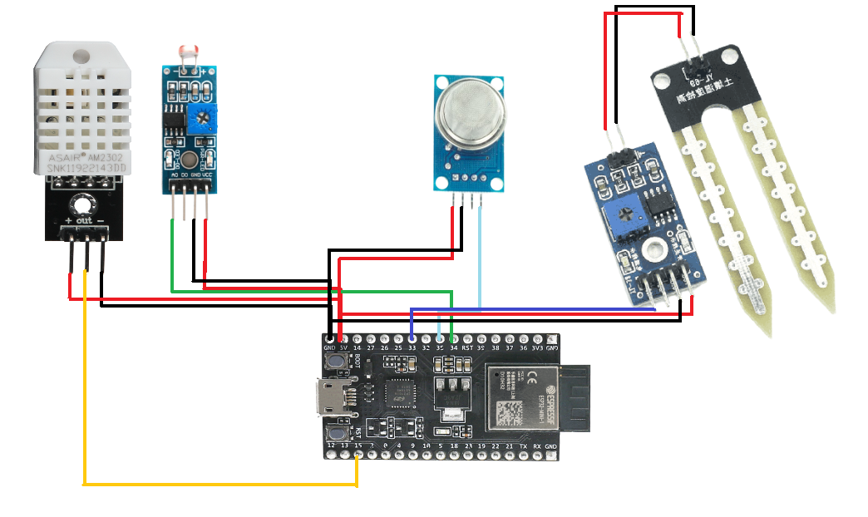
Circuit Diagram

Slide 9
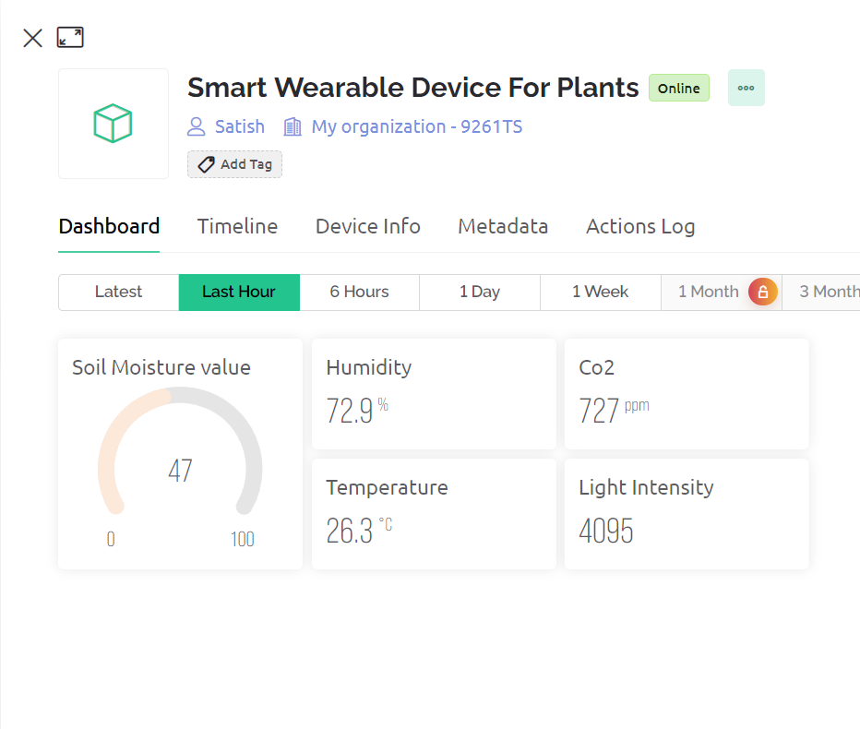
Working
Sensor Integration: The main part of the control system is its set of sensors that includes water moisture sensors, CO2 sensors, thermos and hygroscopic ones, and LDR.G The wearable device is equipped with sensors that enable simultaneous measurements of key plant parameters.
Online Integration: This way, the user can connect it with online services such as Blynk or thing speak and get all relevant information about his/her plants from any location that has access to the Internet. The online integration makes the device easier to use because its accessible.
User Interface: It has an understandable and simple design that is often available as a smartphone app or an online site. This interface enables users to look at real time readings from the sensors; it also allows them to input threshold values and get alerts.

Slide 10
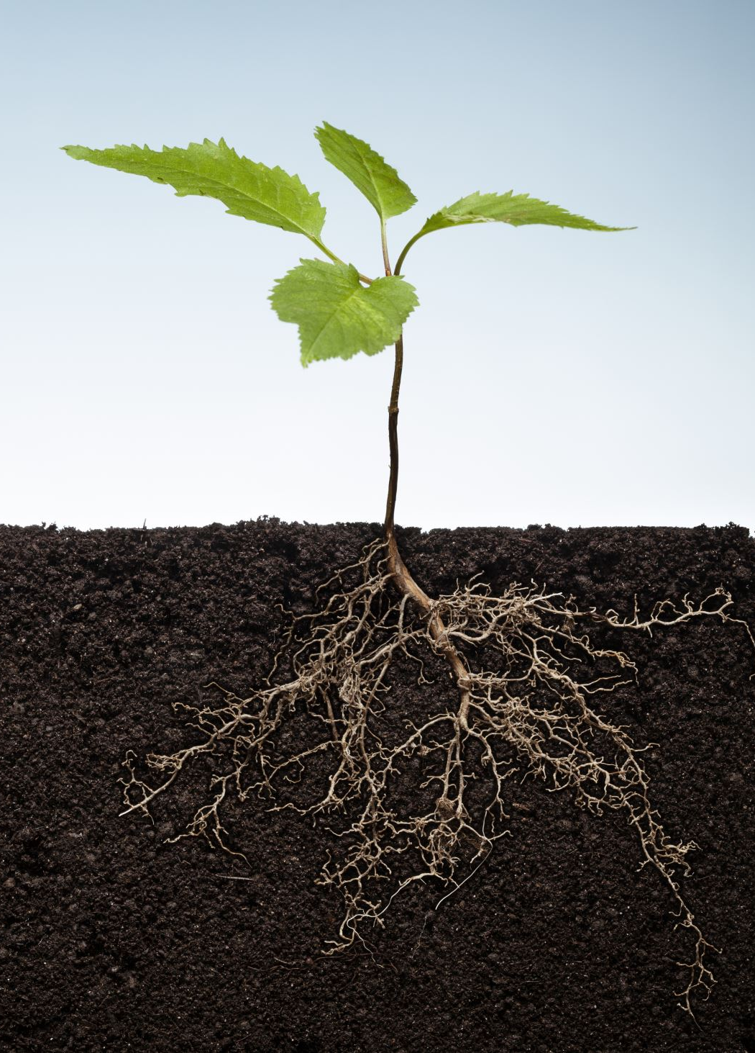
Why It's Important
Why are we doing this? Because plants are vital. They give us clean air and tasty food. But sometimes, taking care of them can be a bit tricky. Our smart plant gadget is like a plant superhero.
It makes sure they get just the right amount of sunlight, water, and care. And when it does that, it's not only making your life easier but also helping the environment. Our project is a small step towards a world with more greenery and sustainability, making it a better place for all of us.

Slide 11
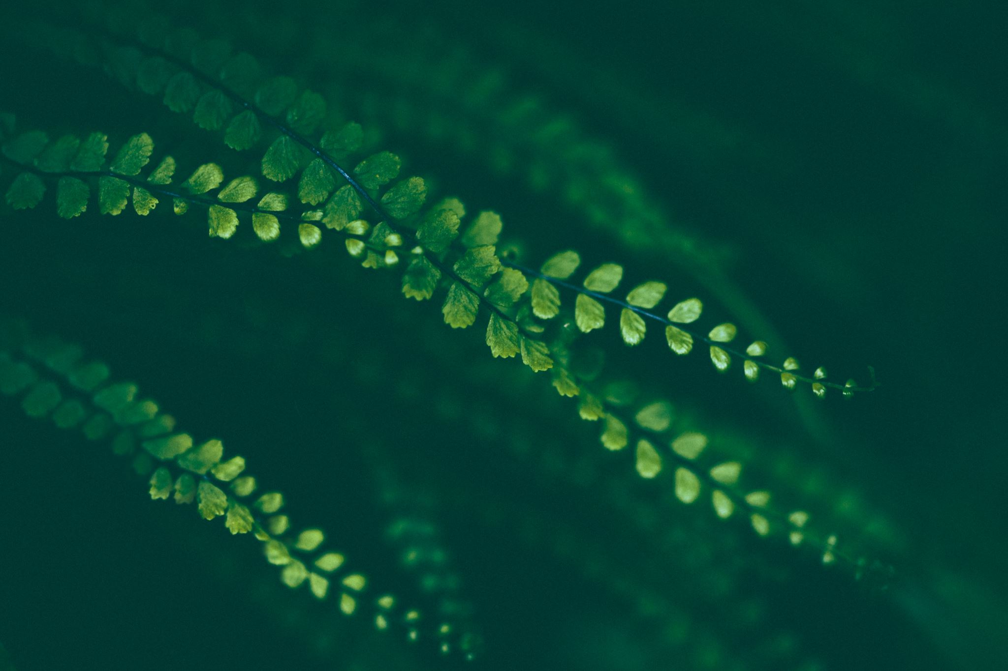
ADVANTAGES OF THE INVENTION
Low-cost: The device is made using inexpensive components, making it affordable for a wide range of consumers.
Wearable: The device is small and lightweight, so it can be easily attached to a plant's stem. This makes it ideal for monitoring plants in both indoor and outdoor settings.
Real-time data collection: The device can collect data on plant health in real time. This allows users to quickly identify and address any problems.
Easy to use: The device is easy to use and requires no technical expertise. Users can simply attach the device to the plant and start monitoring.

Slide 12
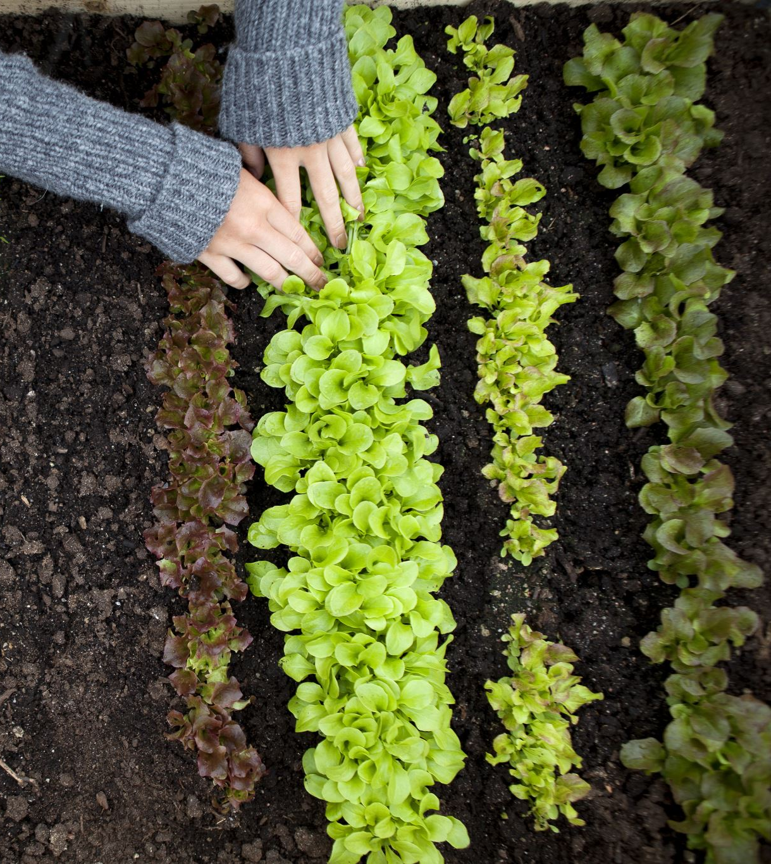
Conclusion
Farmers are using smart wearable devices to monitor the moisture levels in their soil, which helps them to avoid over-irrigation.
Growers are using smart wearable devices to track the temperature and humidity in their greenhouses, which helps them to ensure optimal growing conditions.
Consumers are using smart wearable devices to monitor the growth of their houseplants, which helps them to identify and address any problems early on.
Managing water resources: Smart wearable devices can be used to monitor soil moisture levels and water usage, which helps farmers and growers to conserve water and use it more efficiently.

